Slide 1
WEB APPLICATION FRAMEWORKS
Dr. Swarna Priya RM

Slide 2

Web Applications
A web application is a Client-Server computer program that utilizes web browsers and web technology to perform tasks over the Internet.

Slide 3
Working Principle
User triggers a request to web server
Web server forwards this request to the web application server
Web application server performs the requested task
Web application server sends results to web server
Web server responds back to client

Slide 4
Frameworks
Software Framework designed to reduce overhead in web development
Types of Framework Architectures
Model-View-Controller (MVC)
Push vs Pull Based
Most MVC Frameworks user push-based architecture “action based” (Django, Ruby on Rails, Symfony, Stripes)
Pull-based or “component based” (Lift, Angular2, React)
Three Tier Organization
Client (Usually the browser running HTML/Javascipt/CSS)
Application (Running the Business Logic)
Database (Data Storage)

Slide 5
MVC Framework
Software design pattern for developing web applications
Software architecture pattern which separates the representation of information from the users interaction with it
Here M stands for Model, V stands for View and C stands for controller

Slide 6
MVC (Model View Controller)
Model (M):
Where the data for the DOM is stored and handled)
This is where the backend connects
View (V):
Think of this like a Page which is a single DOM
Where changes to the page are rendered and displayed
Control (C):
This handles user input and interactions
Buttons
Forms
General Interface

Slide 7
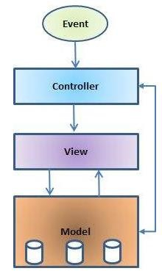
MVC Architecture

Slide 8
MVC-contd.
Model:
Responsible for managing the data of the application
It responds to the request from the view and it also responds to instructions
from the controller to update itself
Lowest level pattern which is responsible for maintaining data
Represents the application core (for instance a list of database records)
Also called the domain layer

Slide 9
MVC-contd.
View:
The View displays the data (the database records)
A view requests information from the model, that it needs to generate an
output representation
Presents data in a particular format like JSP, ASP, PHP
MVC is often seen in web applications, where the view is the HTML page

Slide 10
MVC-contd.
Controller:
It is the part of the application that handles user interaction
Typically controllers read data from a view, control user input, and send input
data to the model
It handles the input, typically user actions and may invoke changes on the model and view

Slide 11
